Slide 1
Simulation of Solar System
Based on Python, Pygame
Author: Ian Chang, Yi-Jhan Huang
PPT Template by: slidesgo.com

Slide 2
01
02
03
04
Introduction
Class Planet
Simulations
Analysis
Overview & Goal
Packages Require
Functions, Variables, and
Related Mathematics
Main Simulation Function Usage
And Result Present
Further Analysis Based on Simulation

Slide 3
Introduction
01
Overview & Goal, Packages Require

Slide 4
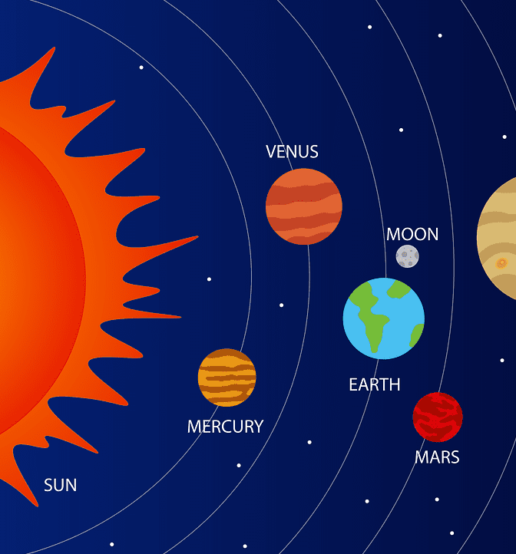
Overview & Goal
Simulation and Analysis of Solar System
Visualization

Slide 5


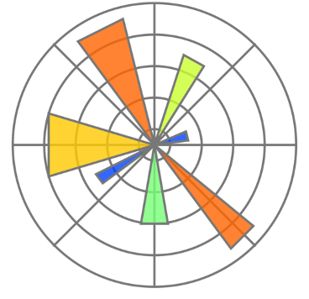
Packages Requirement
Numpy
Pygame
Matplotlib
Math Calculation
Simulation
Graphic Analysis

Slide 6
Class Planet
02
Functions, Variables, and
Related Mathematics

Slide 7
Global Variables
class Planet:
# distance from earth to sun
AU = 149.6e6 * 1000
# gravitational constant
G = 6.67428e-11
# small value to scale down the solar system
to fit it on the screen
SCALE = 200 / AU
# 1 day
TIMESTEP = 60 * 60 * 24
# mass of sun
MASS_OF_SUN = 1.98892 * 10 ** 30

Slide 8
Constructor
def __init__(self, name, dis_to_sun, radius, color, mass):
self.name = name
self.x = -dis_to_sun * Planet.AU # x position
self.y = 0 # y position
self.radius = radius # radius
self.color = color # color
self.mass = mass # mass
self.sun = (dis_to_sun == 0) # If dis_to_sun = 0, it would be the sun of the system
self.dis_to_sun = dis_to_sun * Planet.AU # distance from planet to sun
if (self.sun): Planet.MASS_OF_SUN = mass
self.orbit = []
self.x_speed = 0 # x speed
# y speed
self.y_speed = 0 if (self.sun) else math.sqrt((Planet.G * Planet.MASS_OF_SUN) / self.dis_to_sun)

Slide 9

Constructor
self.y_speed = 0 if (self.sun) else math.sqrt((Planet.G * Planet.MASS_OF_SUN) / self.dis_to_sun)
Orbital Speed Equation - Circular Orbit
G = Planet.G
M = Planet.MASS_OF_SUN
r = self.dis_to_sun

Slide 10
Function: Attraction
def attraction(self, other):
distance_x = other.x - self.x # distance between x positions
distance_y = other.y - self.y # distance between y positions
distance = math.hypot(distance_x, distance_y) # distance between planets
force = self.G * self.mass * other.mass / distance ** 2 # force between the planets
theta = math.atan2(distance_y, distance_x) # angle between the planets x and y positions
force_x = math.cos(theta) * force # force in the x direction
force_y = math.sin(theta) * force # force in the y direction
return force_x, force_y

Slide 11
Function: Attraction
def attraction(self, other):
Main planet
(type: class Planet)
Planet to Compare with
(type: class Planet)

Slide 12
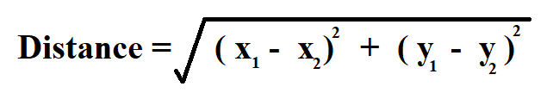

Function: Attraction
distance_x = other.x - self.x # distance between x positions
distance_y = other.y - self.y # distance between y positions
distance = math.hypot(distance_x, distance_y) # distance between planets
x1 = other.x
x2 = self.x
y1 = other.y
y2 = self.y

Slide 13
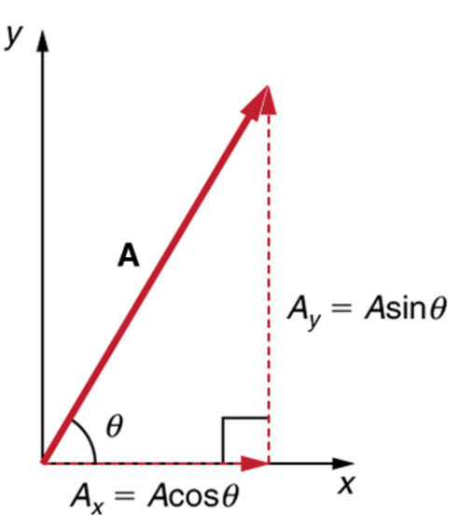
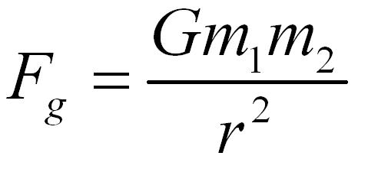
Function: Attraction
force = self.G * self.mass * other.mass / distance ** 2 # force between the planets
theta = math.atan2(distance_y, distance_x) # angle between the planets x and y positions
force_x = math.cos(theta) * force # force in the x direction
force_y = math.sin(theta) * force # force in the y direction
G = self.G
m1 = self.mass
m2 = other.mass
r = distance
A = force
Ax = force_x
Ay = force_y

Slide 14
Function: Update Position
def update_pos(self, planets):
total_fx = total_fy = 0 # initialize x and y force to zero
for planet in planets:
if self == planet: # if the planet is itself
continue
fx, fy = self.attraction(planet)
total_fx += fx
total_fy += fy
self.x_speed += total_fx / self.mass * self.TIMESTEP
self.y_speed += total_fy / self.mass * self.TIMESTEP
self.x += self.x_speed * self.TIMESTEP
self.y += self.y_speed * self.TIMESTEP
self.orbit.append((self.x, self.y))

Slide 15
Function: Update Position
def update_pos(self, planets):
Main planet
(type: class Planet)
List of planets in the system
(type: list of class Planet)

Slide 16
Function: Update Position
total_fx = total_fy = 0 # initialize x and y force to zero
for planet in planets:
if self == planet: # if the planet is itself
continue
fx, fy = self.attraction(planet) # Calculate attraction between two planets
total_fx += fx
total_fy += fy

Slide 17
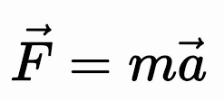
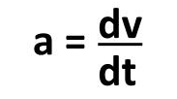
Function: Update Position
self.x_speed += total_fx / self.mass * self.TIMESTEP
self.y_speed += total_fy / self.mass * self.TIMESTEP
self.x += self.x_speed * self.TIMESTEP
self.y += self.y_speed * self.TIMESTEP
self.orbit.append((self.x, self.y))
distance = speed * dt

Slide 18
Function: Update Position
# Draw line function for the updated_points
def move(self):
# divide by two because pygame (0, 0) is the top left corner
x = self.x * self.SCALE + WIDTH / 2 # x position on screen
y = self.y * self.SCALE + HEIGHT / 2 # y position on screen
updated_points = []
for point in self.orbit:
x, y = point
x = x * self.SCALE + WIDTH / 2
y = y * self.SCALE + HEIGHT / 2
updated_points.append((x, y))
return updated_points, (x, y)

Slide 19
Simulation
03
Main Simulation Function Usage
And Result Present

Slide 20
Simulation Set up
pygame.init()
# set pop up screen size
SCREEN = pygame.display.set_mode((WIDTH, HEIGHT))
FONT = pygame.font.SysFont("garamond", 16)
# set title of window
pygame.display.set_caption("Solar System")
clock = pygame.time.Clock()

Slide 21
Main Loop
run = True
count = 0
while run and count != limit:
# Reset Screen (fill the screen black every frame)
SCREEN.fill((0, 0, 0))
# Quit loop when receive quit signal
for event in pygame.event.get():
if event.type == pygame.QUIT:
run = False

Slide 22
Main Loop
for planet in planets:
planet.update_pos(planets) # update the position of the planets using the forces of attraction
updated_points, (x, y) = planet.move() # draw the planets
if len(updated_points) >= 2: pygame.draw.lines(SCREEN, planet.color, False, updated_points)
planet_name_text = FONT.render(f"{planet.name}", True, WHITE)
SCREEN.blit(planet_name_text, \
(x - planet_name_text.get_width() / 2, y - planet_name_text.get_height() / 2 - 20))
pygame.draw.circle(SCREEN, planet.color, (x, y), planet.radius) # draw the planet

Slide 23
Main Loop
pygame.display.update() # update the display
if (delay): clock.tick(60) # Set up update delay
count += 1

Slide 24
Function: Simulation
def simulation(planets, limit=-1, delay=True):
pygame.init()
...
while run and count != limit:
...
pygame.quit()

Slide 25
Example of Execution
Planet('name', dis_to_sun(astronomical unit), radius(self_define for graphic simulation), presenting_color(RGB code), mass_of_planet(Kilogram))
planets = [
Planet('Sun', 0, 30, YELLOW, 1.98892 * 10 ** 30),
Planet('Mercury', 0.387, 8, GREY, 0.330 * 10 ** 24),
Planet('Venus', 0.723, 14, WHITE, 4.8685 * 10 ** 24),
Planet('Earth', 1, 16, BLUE, 5.972 * 10 ** 24),
Planet('Mars', 1.524, 12, RED, 6.39 * 10 ** 23)
]
simulation(planets)

Slide 26
Analysis
04
Further Analysis Based on Simulation

Slide 27
Results
planets = [
Planet('Sun', 0, 30, YELLOW, 1.98892 * 10 ** 30),
Planet('Mercury', 0.387, 8, GREY, 0.330 * 10 ** 24),
Planet('Venus', 0.723, 14, WHITE, 4.8685 * 10 ** 24),
Planet('Earth', 1, 16, BLUE, 5.972 * 10 ** 24),
Planet('Mars', 1.524, 12, RED, 6.39 * 10 ** 23)
]
simulation(planets, limit=10000, delay=False)

Slide 28
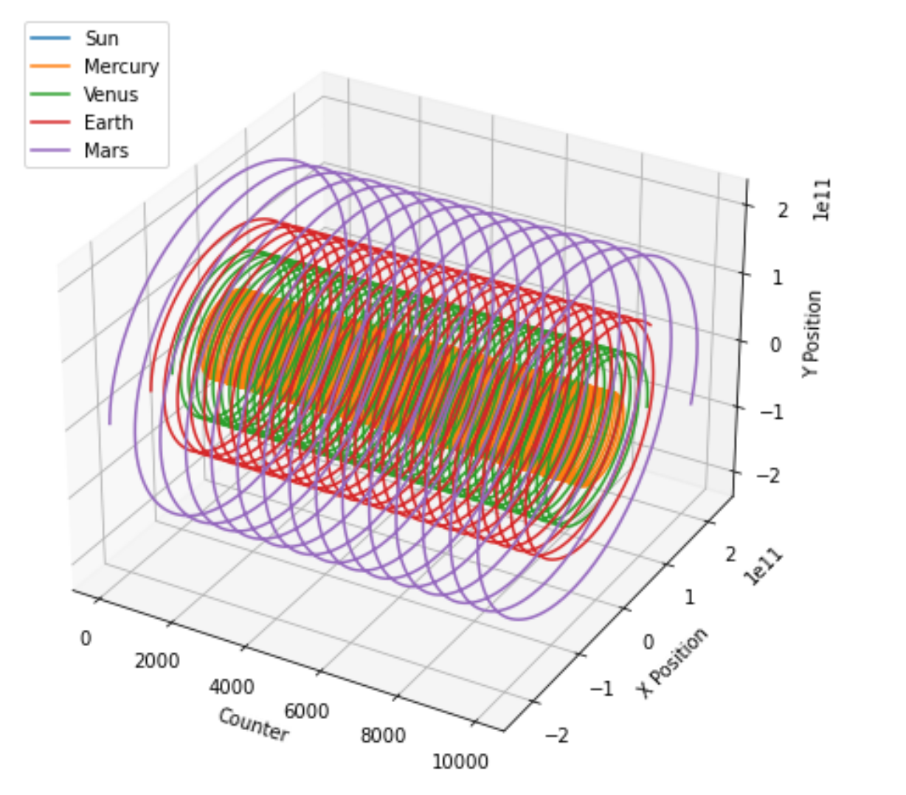
Resulting Path, 3d representation
No clear change of the orbital Path
Changes is too small to be seen from the 3d graph

Slide 29
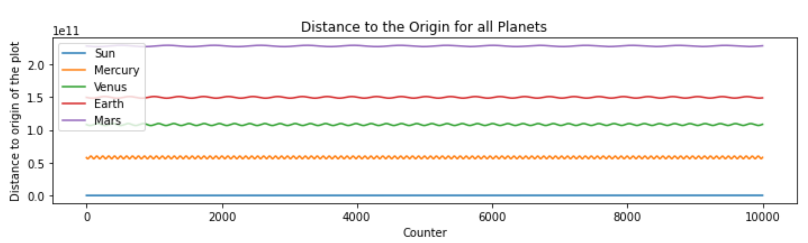
Resulting Path, 2d representation

Slide 30
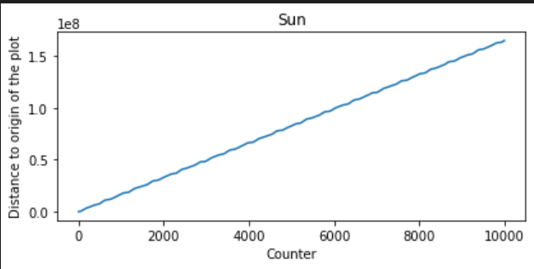
Resulting Path, 2d representation
Not staying at the origin
Continue to Move Away

Slide 31
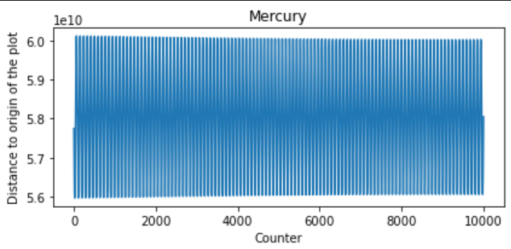
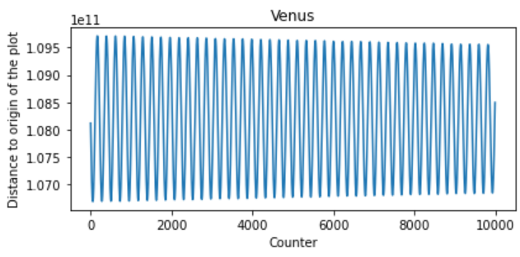
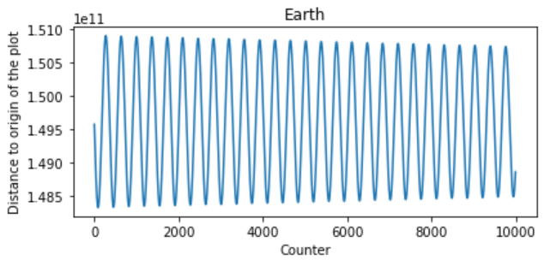
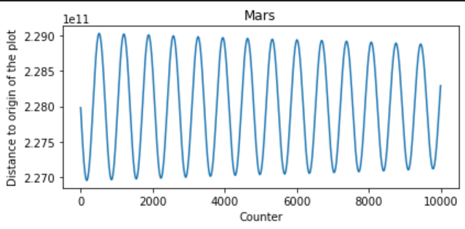
Resulting Path, 2d representation

Slide 32
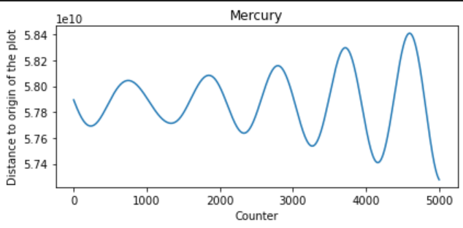
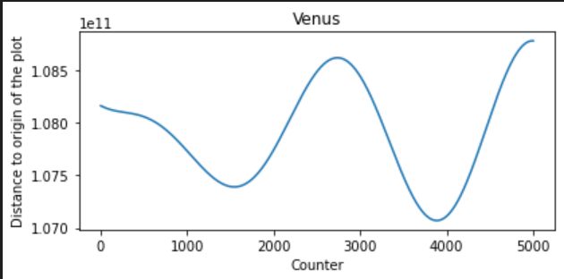
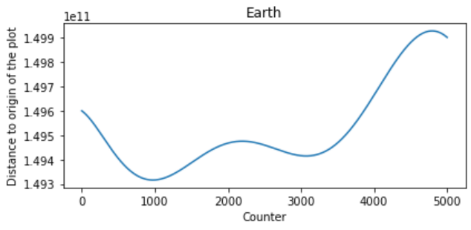
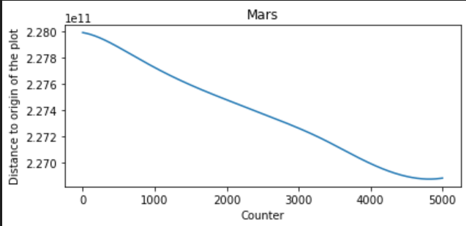
What if?
1. Decrease the mass of sun by 10^2

Slide 33
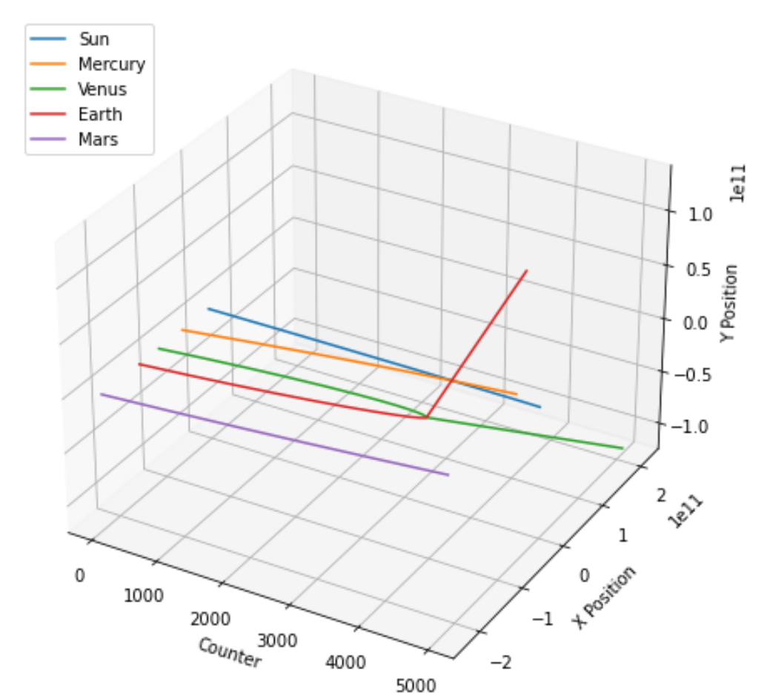
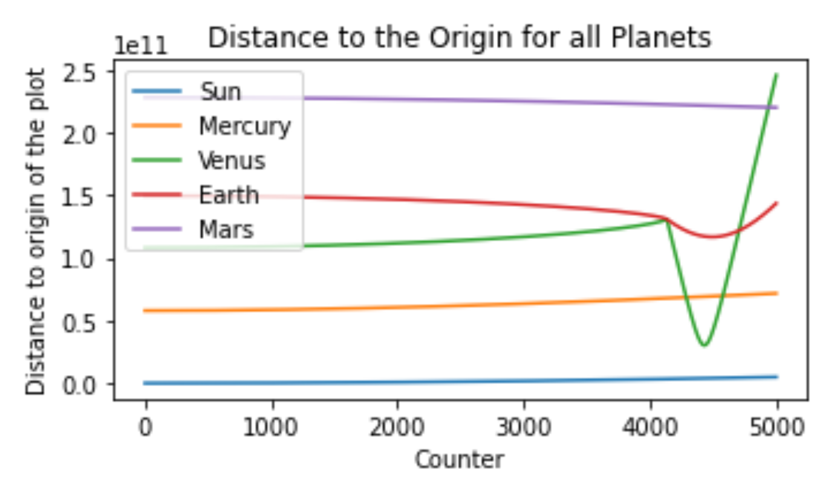
What if?
2. The mass of the Sun = Earth

Slide 34
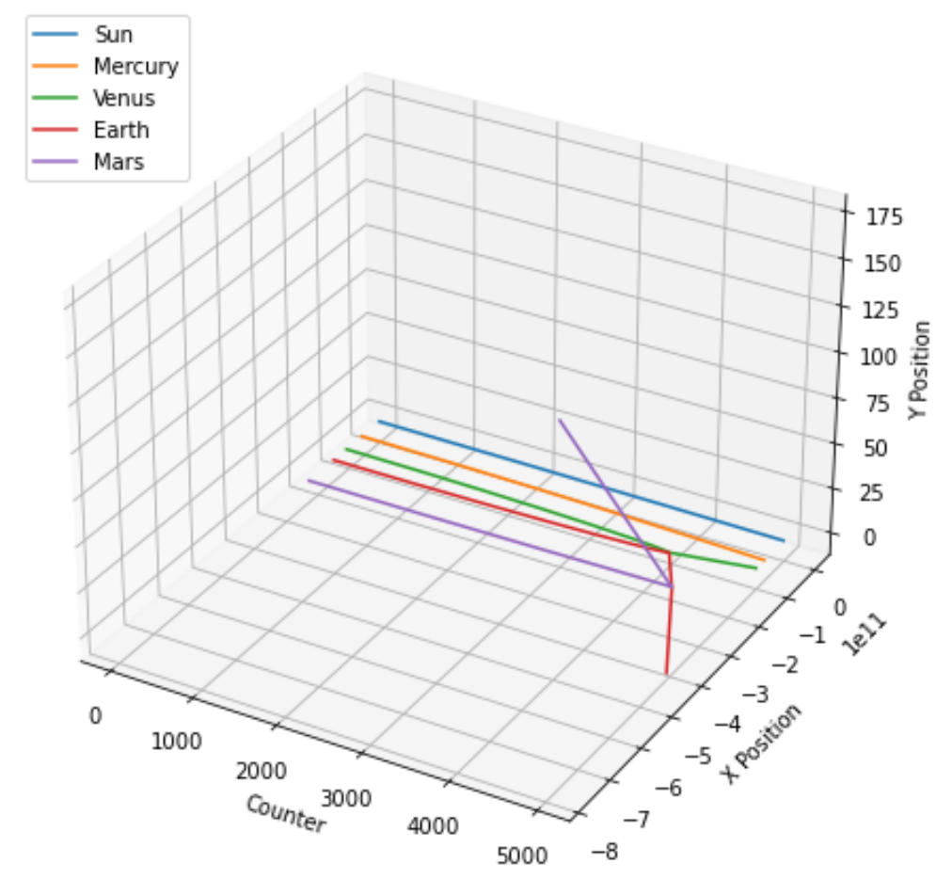
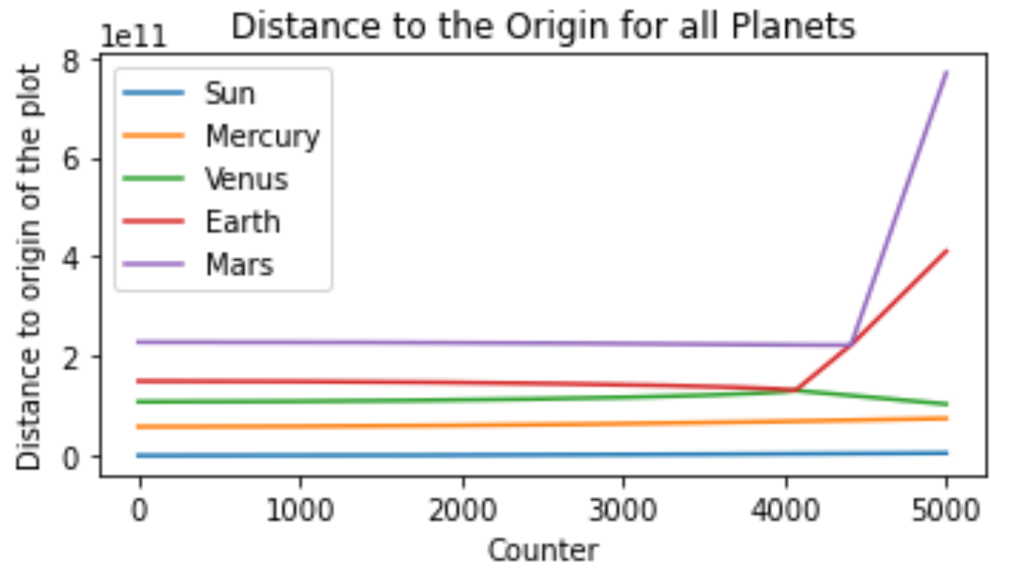
What if?
3. The mass of the Sun = 1

Slide 35
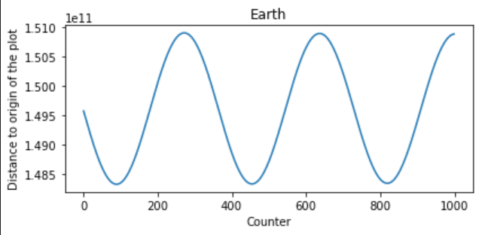
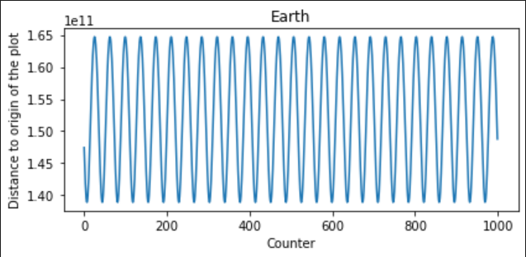
What if?
4. The mass of the Sun is * 100
Original mass
* 100 mass

Slide 36
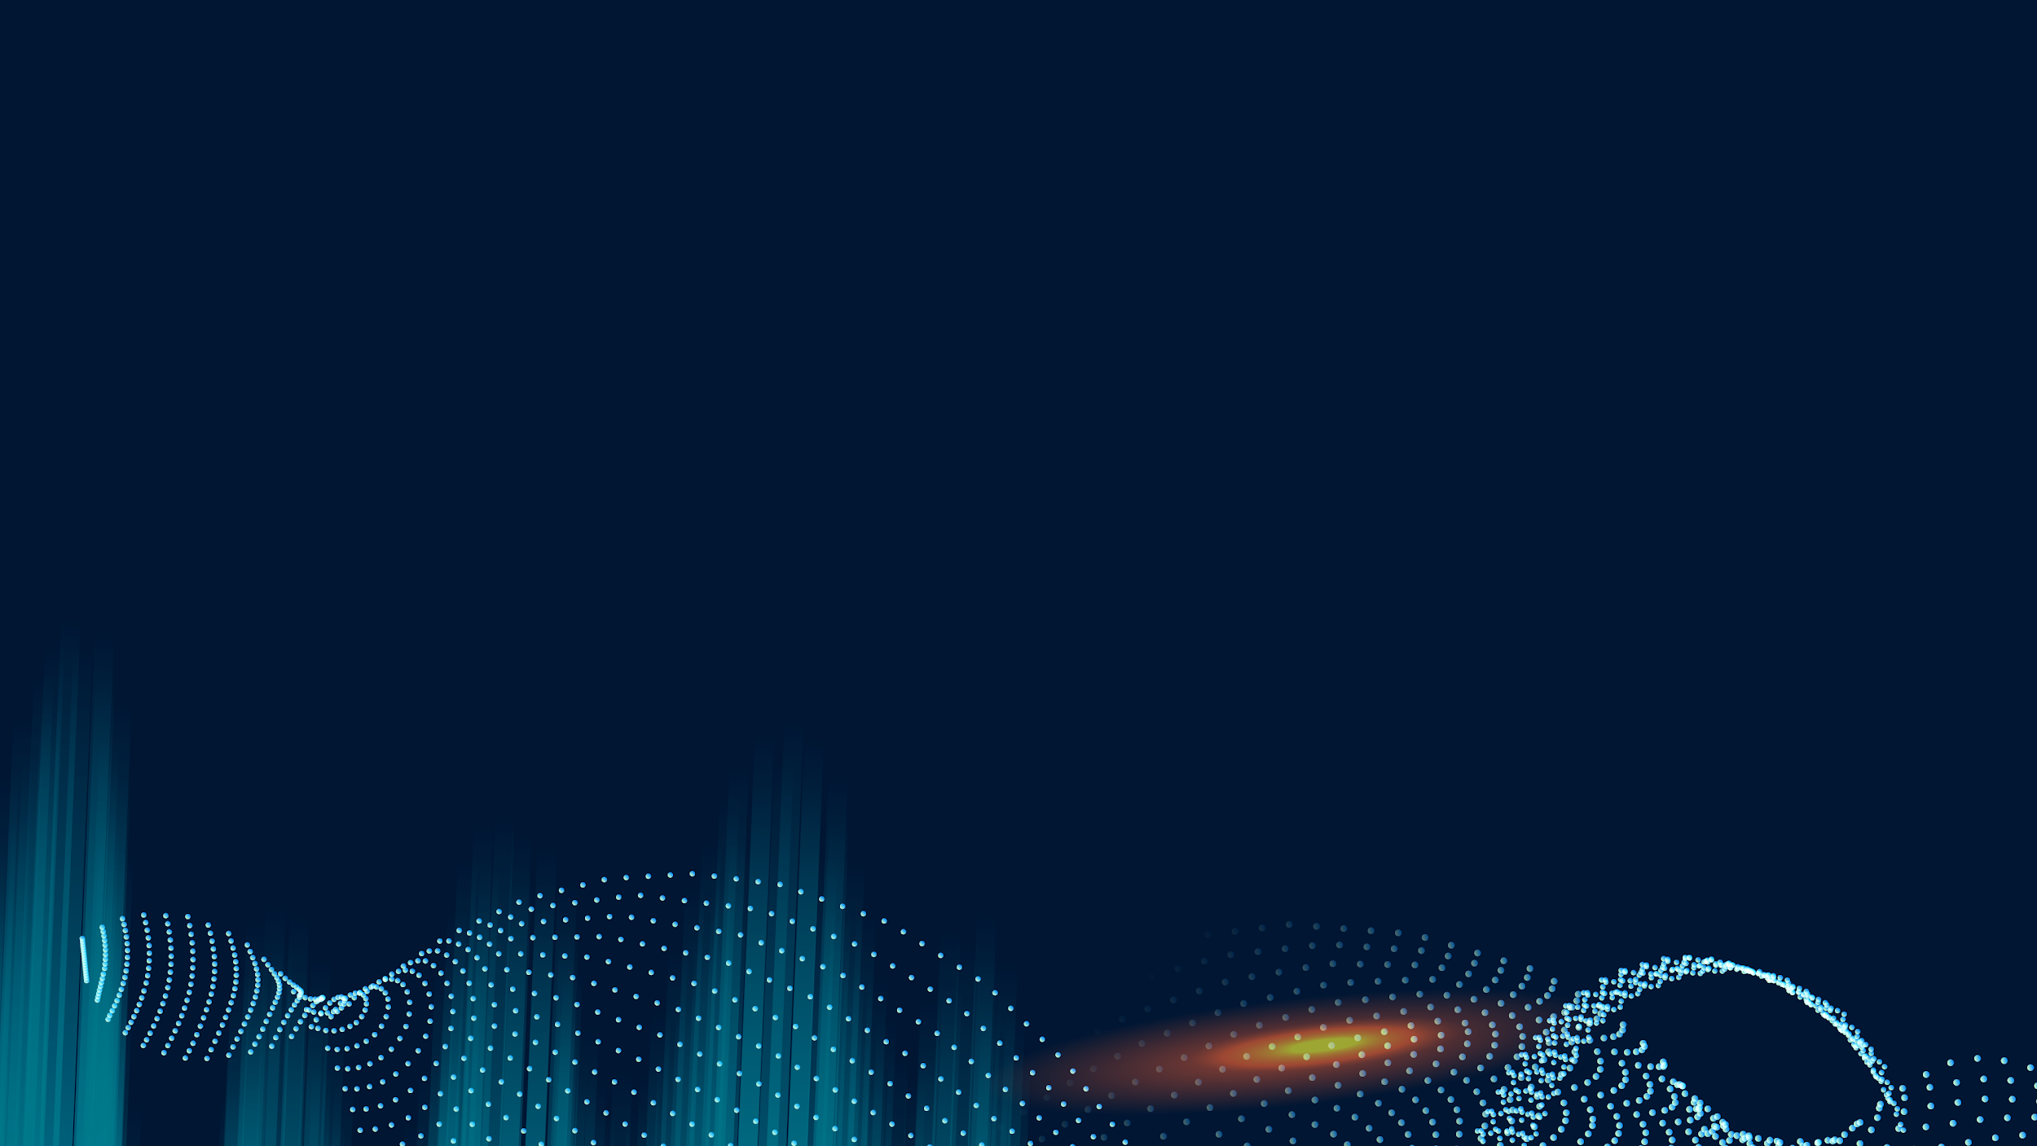
Thank you For Listening

